Slide 1
COEN 5830, Fall 2024 Introduction to Robotics
Lecture 1
Introduction and Overview
Leopold Beuken (leopold.Beuken@Colorado.edu)
Tuesday, 8/27/2024

Slide 2
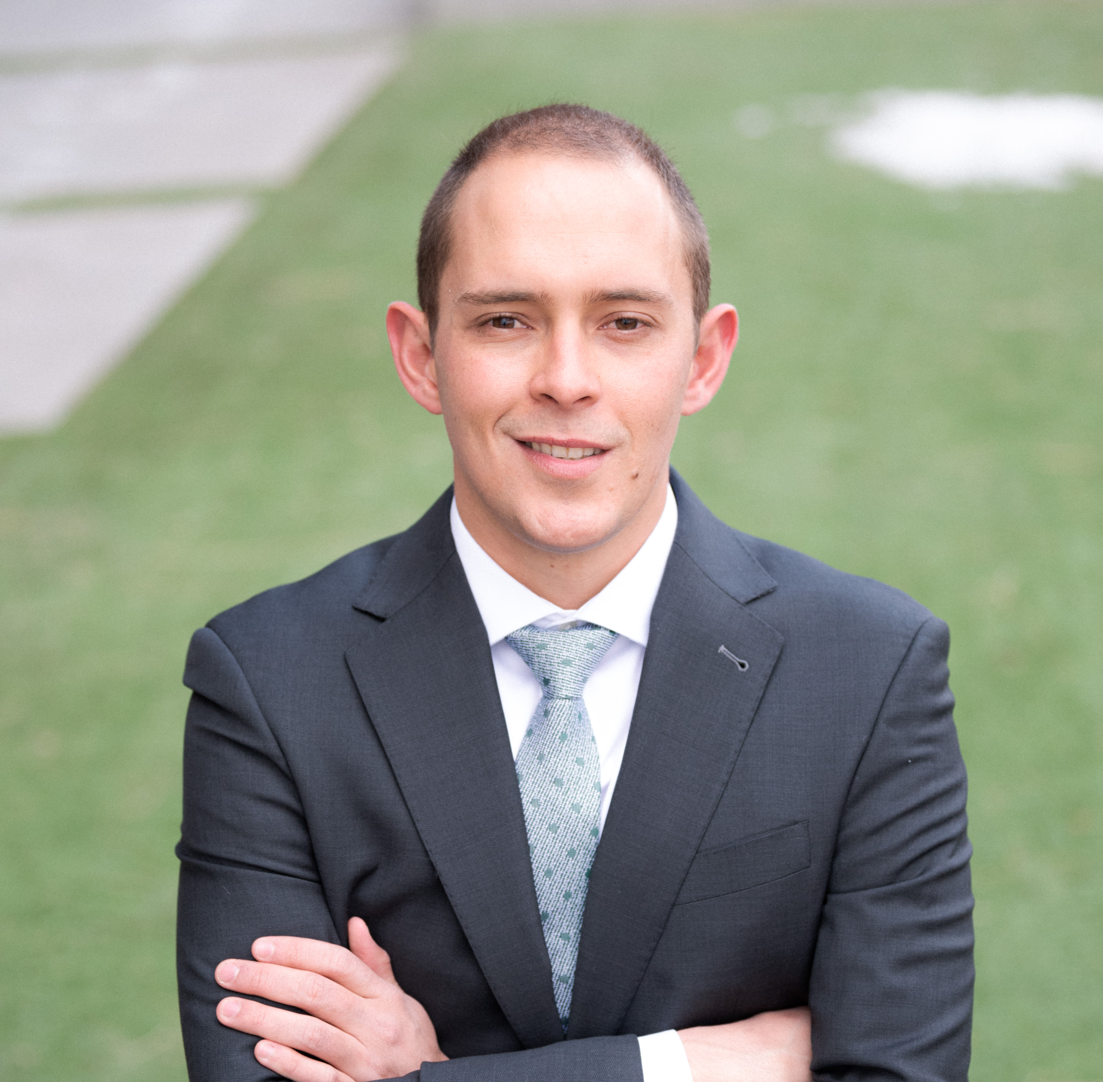

About the Lecturer
Dr. Leopold (Leo) Beuken
Completed PhD at CU Boulder
Research on bio-inspired sensing and sensory processing
Originally from South Africa
Can find me trying to catch trout in a stream or on a golf course when I’m not prepping your lectures.
Super excited about the new robotics program!

Slide 3
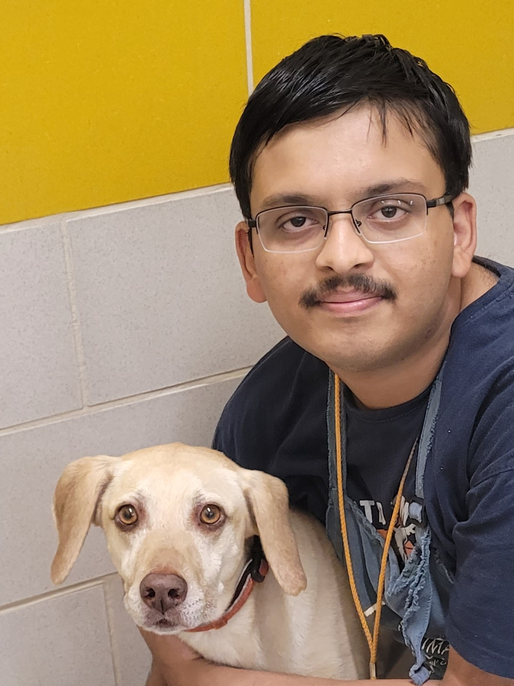
About Me:
Srikrishna Bangalore Raghu
2nd year PhD student in Computer Science
Research Interests: Motion Planning, Expressive Robotics, Non-Prehensile Manipulation
Hobbies: Dancing, Volunteering, Video Games

Slide 4
Talk to your neighbor!
Where do you come from?
What do you like to do for fun?
What other courses are you taking?
One of my missions in the first year is to create a strong robotics student community.
Community and belonging is essential in a small, new program!
Shameless plug for Robotics Seminar course. 1 unit can be repeated up to three times.

Slide 5
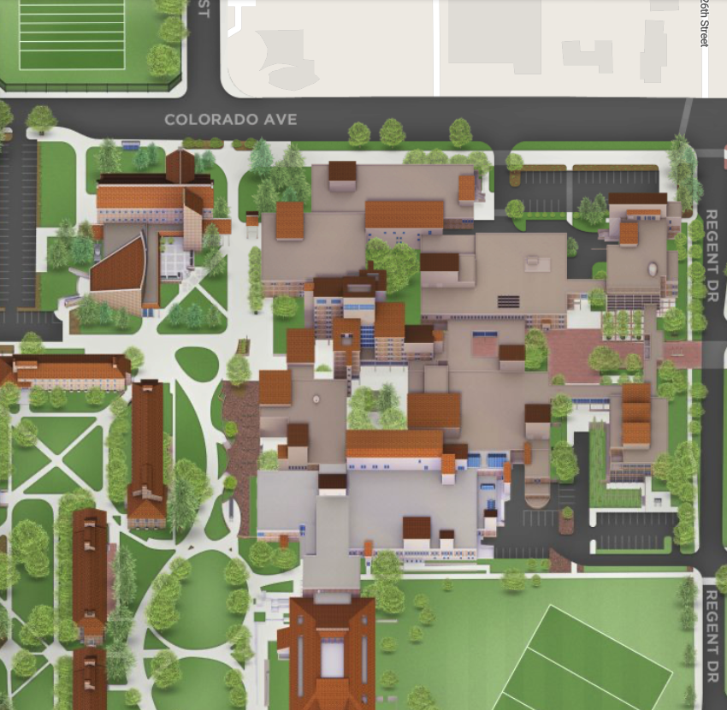
Contact Information
Leo Beuken
Leopold.Beuken@colorado.edu
Office: ECNT 212
Office hours:
Tue 12:00 – 2:30 ECNT 212*
TA: Shrikrishna Raghu
Srikrishna.Bangaloreraghu@colorado.edu
Office hours:
Mon 2:30 – 4:30 ECOT 832*
Fri 2:30 – 3:30 ECCS 114E*
*There is a signup sheet for office hours: https://o365coloradoedu-my.sharepoint.com/:x:/g/personal/lebe3608_colorado_edu/EcsUhEN_TZRNqG19qIN7nH0BNO4pVNO-d9779UlIhV-v0Q?e=tJAIet

Slide 6
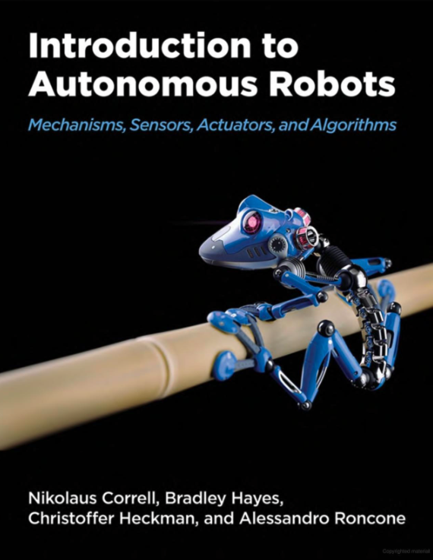
Resources and Website
Textbook is on Github (you need to compile a latex file). Not required, but will serve as an excellent resource. Complete lecture notes will be made available. https://github.com/Introduction-to-Autonomous-Robots/Introduction-to-Autonomous-Robots
All course materials (notes, homeworks, midterms, etc.) will be on the course Canvas page: https://canvas.colorado.edu/courses/110700
Piazza will serve as the primary platform for course-related questions. This is an online forum style website that allows students to ask questions that are visible to everyone in the course. This way everyone learns from each others' questions. You are encouraged to answer each others’ questions! https://piazza.com/colorado/fall2024/coen5830 Access code: grohl
Grading inquiries are to be directed to Srikrishna.
Please only email me with personal questions/comments, otherwise post on Piazza.

Slide 7
Classroom Atmosphere
Laptops in the back please
I will ask you many questions
Please stop me with questions!
Lecture style is discussion-based
Please be on time

Slide 8
Assessments and Lectures
No exam
1 at-home midterm (20%)
2 hours to complete midterm individually in 48 hour period*
1 Final Project (30%)
Homework Assignments (50%)
Every 2-3 weeks (6-8 total)
Solutions will be posted
Collaboration encouraged, but you need to submit your own work
No late submissions will be accepted

Slide 9
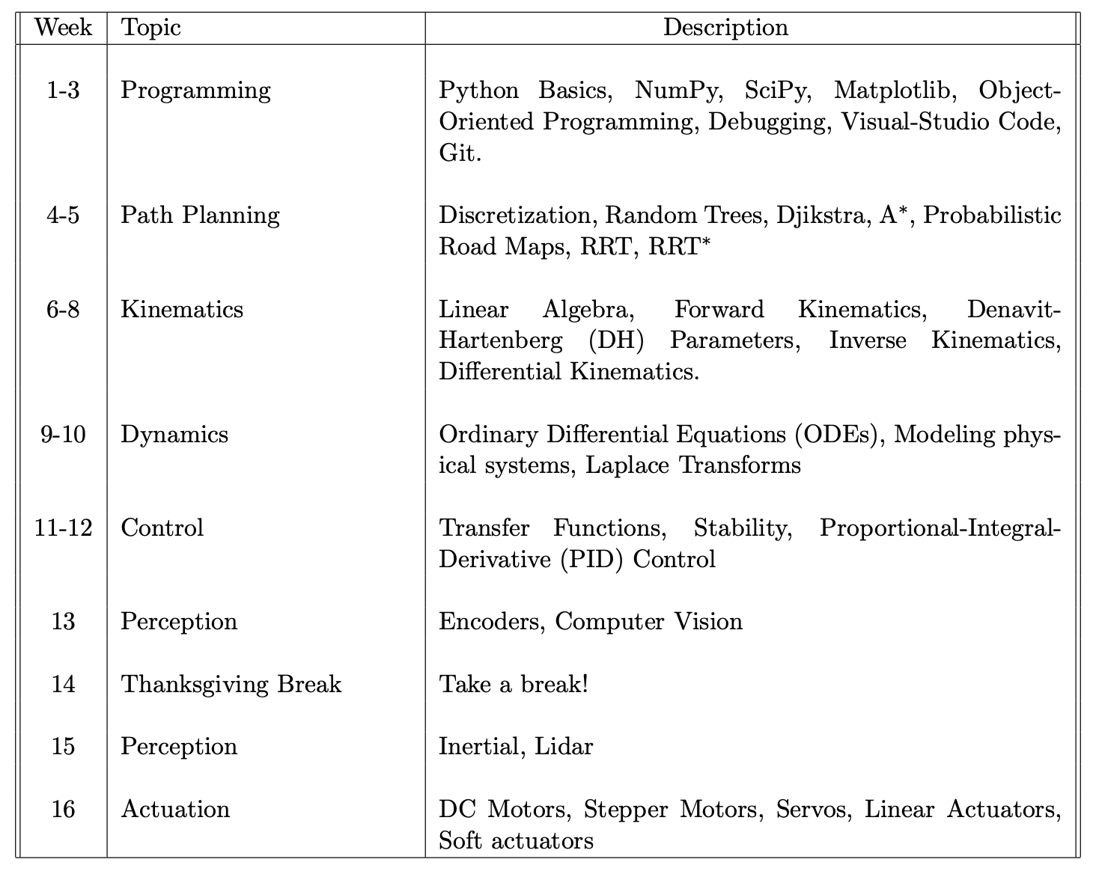
Course Overview and Schedule

Slide 10
Course Goals
There are students from diverse technical backgrounds (that’s the point of having the robotics program!)
Modeling
Software
Hardware
Algorithms
Modeling
Software
Hardware
Algorithms
Modeling
Software
Hardware
Algorithms
Student 1
Student 2
Student 3

Slide 11
Course Goals
Get everyone up to an appropriate level of core competency in all aspects of robotics
Modeling
Software
Hardware
Algorithms
Modeling
Software
Hardware
Algorithms
Modeling
Software
Hardware
Algorithms
Student 1
Student 2
Student 3

Slide 12
Course Goals
Get everyone up to an appropriate level of core competency in all aspects of robotics
What does this mean for you? Parts of the course may be challenging, other parts may seem trivial.
Modeling
Software
Hardware
Algorithms
Modeling
Software
Hardware
Algorithms
Modeling
Software
Hardware
Algorithms
Student 1
Student 2
Student 3

Slide 13
A Note on Graduate School
What does this mean for you? Parts of the course may be challenging, other parts may seem trivial.
Embrace the challenge of hard topics! During grad school you have incredible freedom (and time!) to learn new topics and skills – take advantage of this. “I can’t do that because that’s not my background” is never an excuse, make it your background!
Don’t neglect the things you are already well-versed in. There is always more to learn and different perspectives to understand. These topics can often catch you out if you become complacent.
Each of us has a unique opportunity to help shape the Robotics Program in its early stages.

Slide 14
Accommodations
Remember to let Disability Services know if you need accommodations! https://www.colorado.edu/disabilityservices/
Accommodations can’t be provided without an official letter from Disability Services
Handle this ASAP if you haven’t already.
If you require religious accommodations, you are required to let me know by the end of the week.

Slide 15
Academic Dishonesty
Collaboration is strongly encouraged – help shouldn’t only come from the instructor/TA, you can help one another! You must indicate collaborators with every homework submission.
You must complete individual assignments by yourself
For this introductory course, use of AI or LLMs is strictly prohibited. This defies the point of forming basic understanding of robotics principles.
Incidents of academic dishonesty is taken very seriously in the Robotics Program

Slide 16
Topic 1: Programming
Self assessment – am I proficient at programming? Am I proficient at Python? How often do I write code? Do I write code by myself or do I copy and paste?

